Slide 1
2d Adventure Game using Pygame for Psychological Assessment
Made by - Naman Verma (211257)

Slide 2

Content
1)Introduction
2)Libraries used
3)Classes used
4)What could it do?
5)Example Outputs
6)Sources

Slide 3


1. Intro
Why do people play games?
What goes through their heads while playing games?
How is it connected to real life?
How can we assess someone based on their gaming skills?
Our objective is to create a full functional 2d shooter game and try to access players nature during the game.

Slide 4
People of all ages play video games for many different reasons. Video games serve a purpose and everyone plays for a reason. Identifying your motivation to play can be helpful to maintain moderation or shift your desire to other activities.
In this project we learned how to use pygame to create a 2d game ,using various classes and also tried to judge a players psychological state while playing the game.

Slide 5
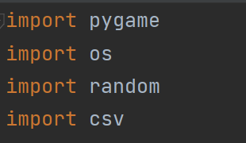
Libraries used :
Pygame is a cross-platform set of Python modules designed for writing video games. It includes computer graphics and sound libraries designed to be used with the Python programming language.
The OS module in Python provides functions for interacting with the operating system. OS comes under Python’s standard utility modules. This module provides a portable way of using operating system-dependent functionality. The *os* and *os.path* modules include many functions to interact with the file system.

Slide 6
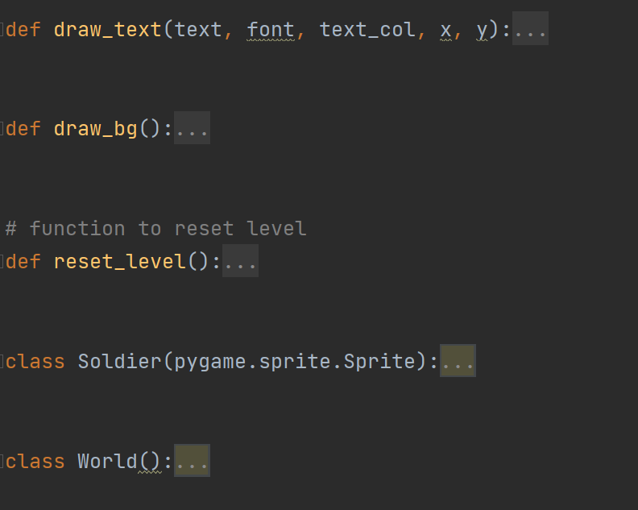
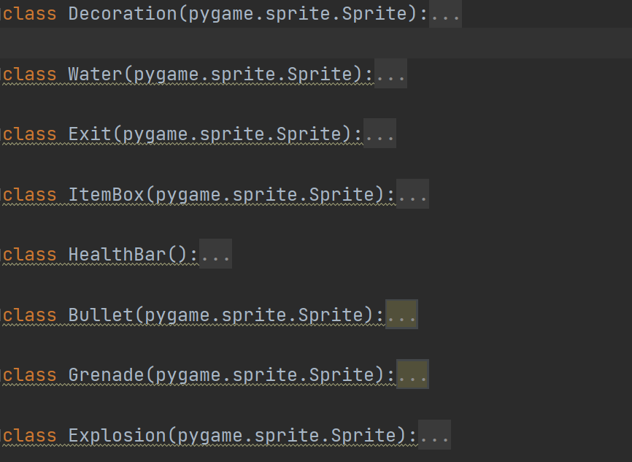
METHODS USED :
Concepts of object oriented programming
Pygame methods
classes:

Slide 7
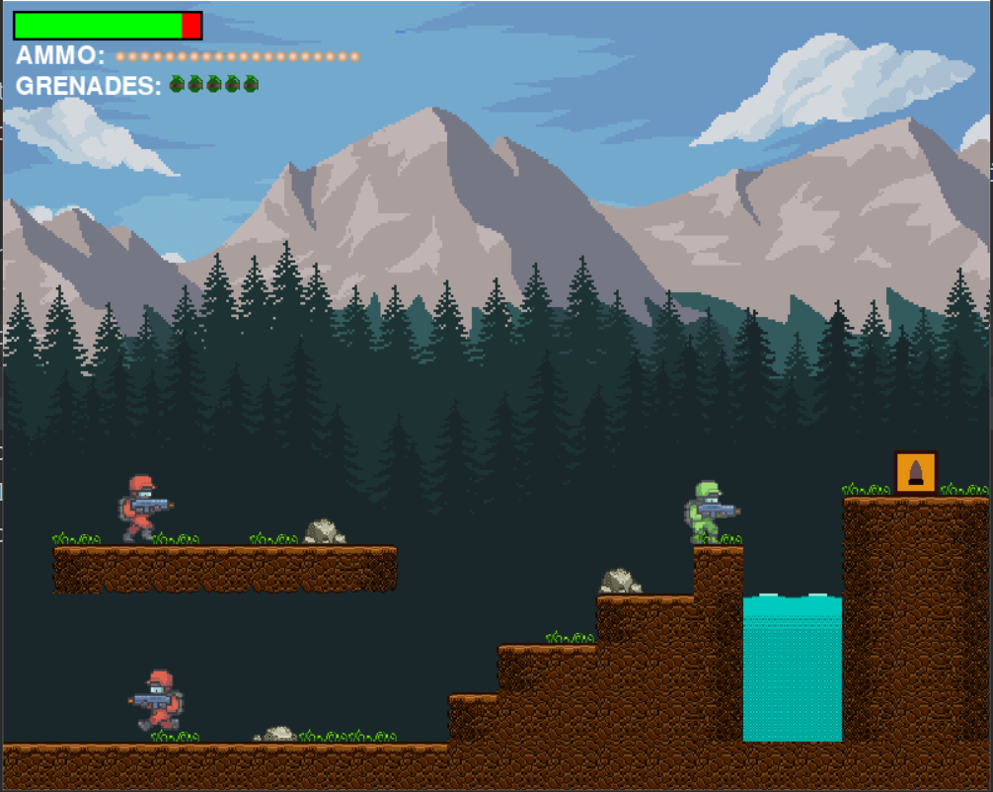
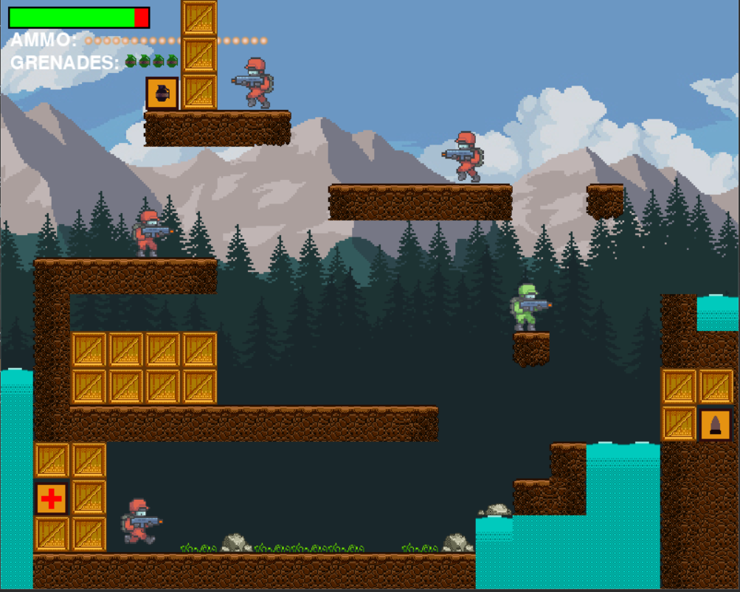
Game levels examples

Slide 8
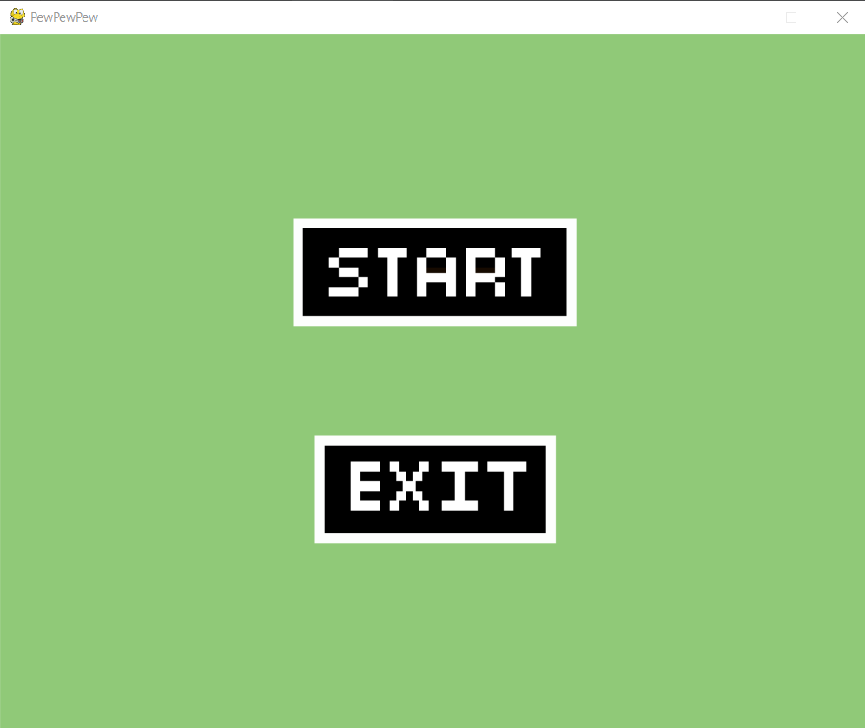
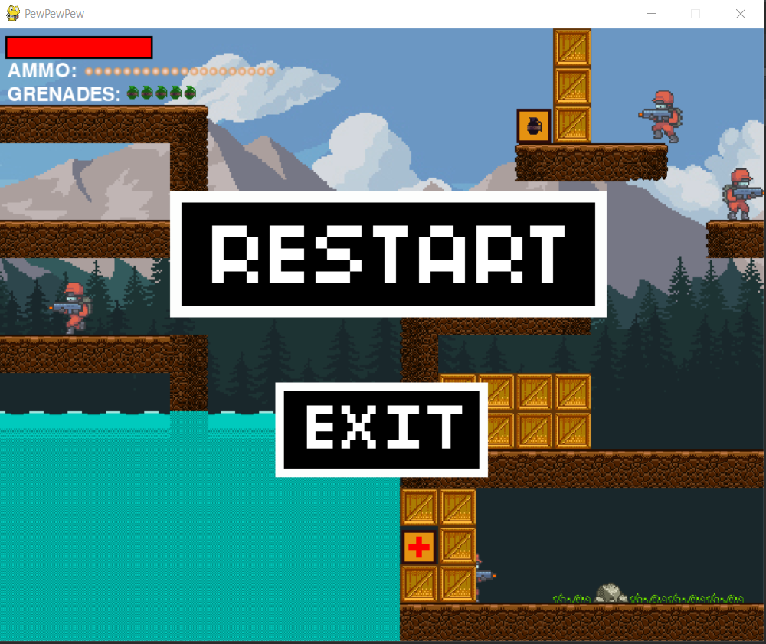
Interfaces:

Slide 9
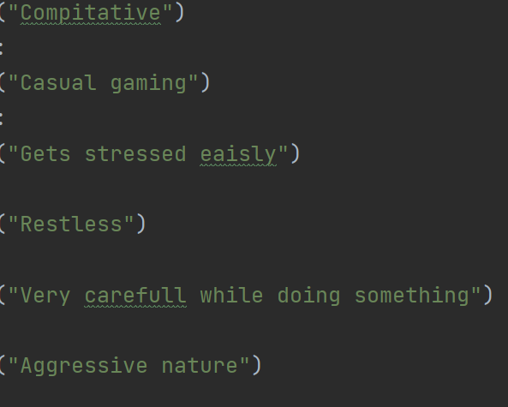
Player types :

Slide 10
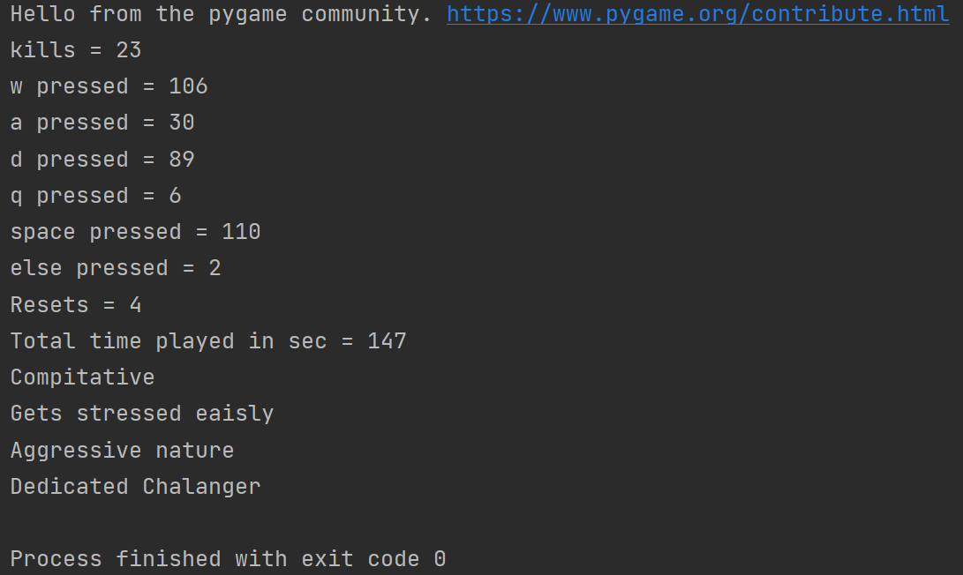
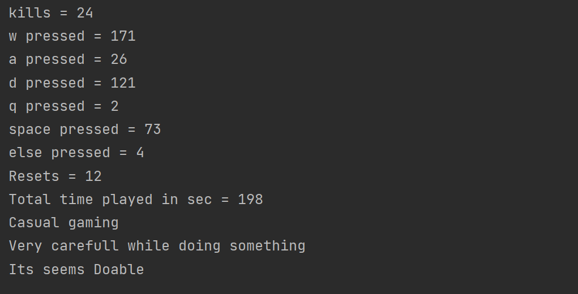
Sample outputs
(player assessment)
Player 1 (completed the game)
Player 2

Slide 11
Sources and Assets
https://mtk.itch.io/grenades-16x16
http://gushh.net/blog/free-game-sprites-explosion-3/
https://erayzesen.itch.io/pixel-platformer
https://secrethideout.itch.io/team-wars-platformer-battle
https://pubmed.ncbi.nlm.nih.gov/27809571
https://www.sekg.net/gamer-psychology-people-play-games/

